Slide 1

DEPARTMENT OF INFORMATION SCIENCE & ENGINEERING
SDM INSTITUTE OF TECHNOLOGY
Smart Shoe For Blind People
Under the guidance of
Mrs. Shobha
Assistant Professor
Department of ISE
SDMIT, Ujire
Presented By
P J Prajanya Jain 4SU20IS028
Pooja 4SU20IS029
Prathvin P Shetty 4SU20IS031
Praveen M R 4SU20IS032
TEAM ID:
ISP11

Slide 2
INTRODUCTION
IoT is all about making physical stuffs communicating with each other and, hence our project is based on this application.
India contributes about 21% of the blind people over total population. In a million population, there are around 53 persons that are visually impaired, 46 thousand are having low vision and around 7000 have completely lose the vision
Smart shoes for blind person, This shoe will contain many sensors with features which would help blind persons to their destination. Physical movement is a major challenge for them.
Fire hydrants, potholes, steps, etc. are some of the obstacles people who are blind and low vision need to be careful about.

Slide 3
LITERATURE SURVEY
In this paper titled “Smart Assistive Shoes for Blind”,the authors are N. Sohan, H. S. Sai Rishab et al.They have stated that their project consists of assistive system which helps the blind to find obstacle free path based on the voice commands. The main aim of this research work is to provide a better solution regarding navigation system for blind people with all the mentioned functions.
In this paper titled “Internet of Things - Enabled Smart Shoes for Blind People”,the authors are Pratik Bhongade,Abdul Moeid Sheikh et al.They have stated that this Smart Shoe will be equipped with various sensors and the entire system is powered by two sources: two batteries as a primary source and piezoelectric plates as an alternate source that generates power when a blind person walks.

Slide 4
LITERATURE SURVEY
In this paper titled “Smart Shoes for Visually Impaired Using IOT” the authors are Manali Tayade,Harsh Kadam et al.This paper states that this shoe includes sensors to detect obstacles such as sidewalks, staircases, etc. Entire data received from the wearable sensors is displayed on the android device and the end-user can view and access .
In this paper titled “Smart Footwear for the Visually-Impaired People Based on Arduino Platform and Ultrasonic Sensors”,the authors are Valentina Balas, Muhammad Arif et al. This paper presents use of location system for suggesting the visually-impaired persons about the closest locations such as supermarkets, hospitals, institutions, etc.

Slide 5
LITERATURE SURVEY
In this paper titled “Design and Implementation of Smart Shoes for Blind and Visually Impaired People for More Secure Movements” and the authors are Jeffrey Chehade, Ali Hayek et al and this paper states that this system is developed to detect obstacles, wet floor and if patient fall in case of presence of one of the above incidents, the user will be notified acoustically using some voice alarms.

Slide 6
PROBLEM STATEMENT
Blind and visually impaired people face a number of challenges in their daily lives, including navigating their surroundings safely and independently. Smart shoes have the potential to address these challenges by providing blind and visually impaired people with real-time information about their surroundings and helping them to avoid obstacles.

Slide 7
OBJECTIVES
The objectives of the proposed work are :
To help the blind people to find obstacle free path.
To help the blind to reach the destination independently.
To increase the independence and mobility of the blind people.
To reduce the accidents and injuries of the blind people.

Slide 8
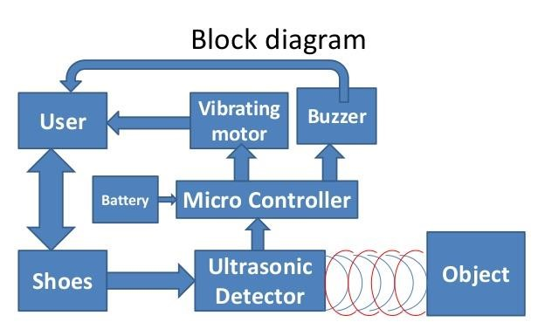
METHODOLOGY
GPS

Slide 9
METHODOLOGY
STEP 1: The shoe consists of Arduino uno to which the ultrasonic sensors, buzzer ,vibrating motor, buzzer, and GPS system is mounted to it.
STEP 2 :The blind person wears this shoe and move towards his desired destination.
STEP 3: If the obstacles occurs the ultrasonic sensors detects the obstacles as it is used to detect obstacle from certain distance makes a buzzer sound to alert the blind person to avoid the obstacle.
STEP 4: Suppose the blind person is also deaf he could not hear the buzzer sound about the obstacle in order to overcome that a vibrating motor is installed in the shoe so that along with the beep sound vibration occurs so that they can sense the obstacle.

Slide 10
STEP 5: If the person feels he is lost by pressing a button the current location of the blind person is sent to the guardian’s phone or parent’s phone this is achieved as we will be installing GPS-GSM tracking system to the shoe.

Slide 11
APPLICATIONS
It is used in Handicapped centres.
It is used in Hospitals.
It is used for ETA (Electronic Travelling Aid)Kit to help blind people to find obstacle free path.
It is used in care taking centres for old people.

Slide 12
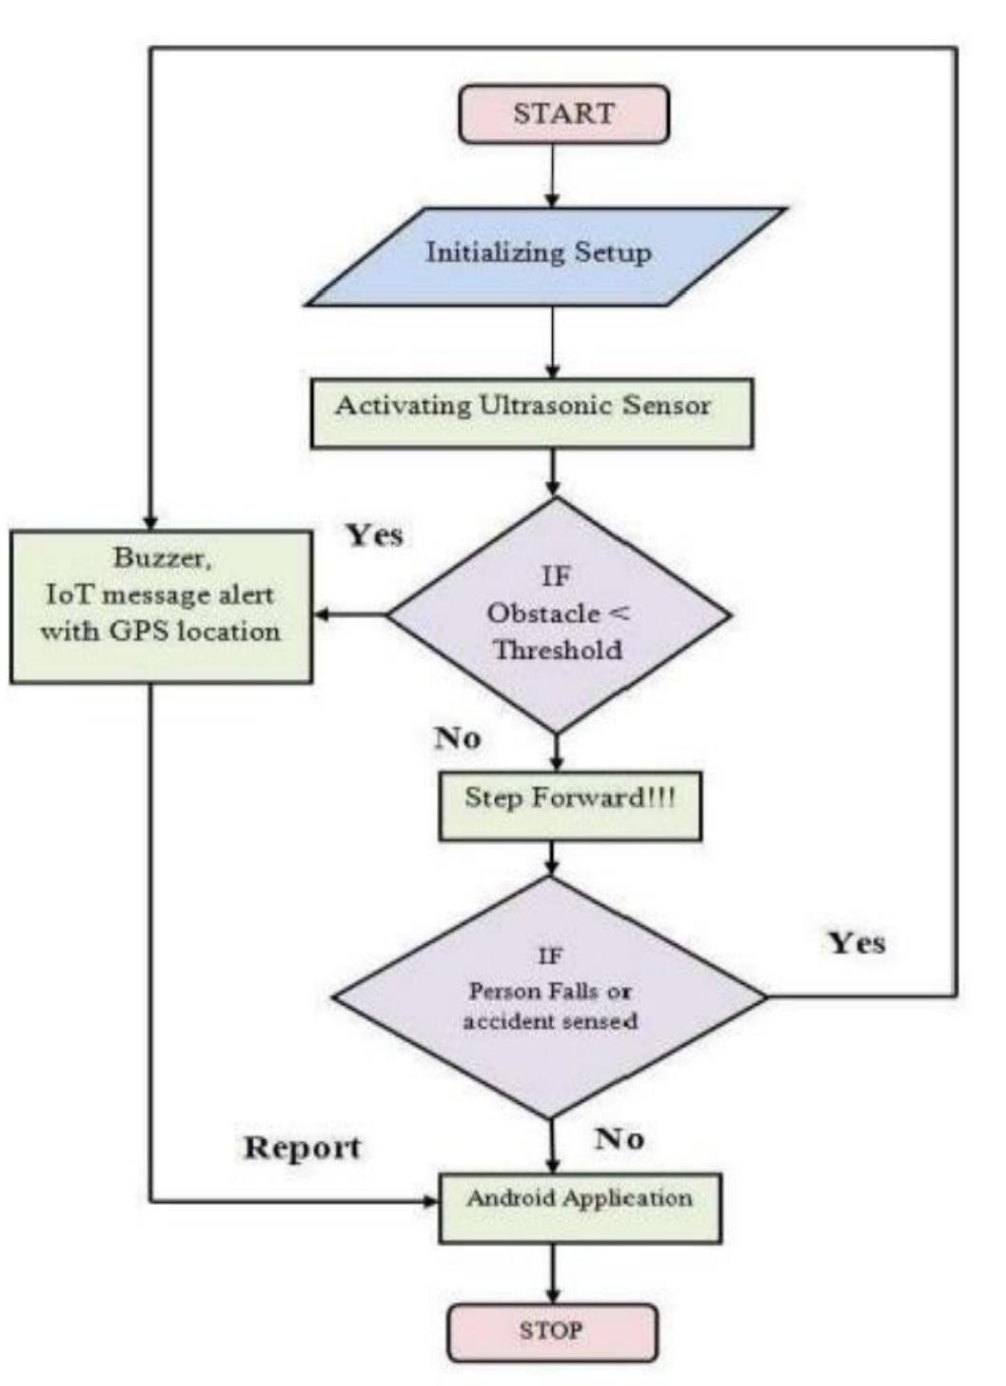
SYSTEM DESIGN
IF
Obstacle is detected
IF
Person is lost or any accident occurs
Android device

Slide 13
HARDWARE AND SOFTWARE REQUIREMENTS
Hardware Requirements:
Arduino Nano
Ultrasonic Sensor (Range upto 20 metres)
Battery (9 v)
Buzzer
Vibrating Motor
Software Requirements:
Embedded C
Arduino IDE Application(version 2.1)

Slide 14
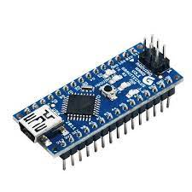
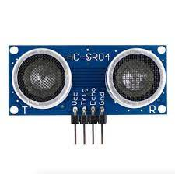
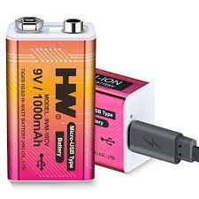
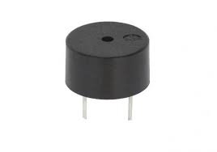
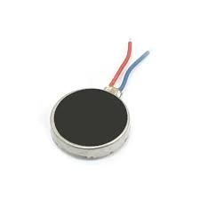
HARDWARE AND SOFTWARE REQUIREMENTS
Hardware Requirements:
Software Requirements:
Embedded C and Aurdino IDE Application
Aurdino nano
Ultrasonic sensor
Battery
Buzzer
Vibrating Motor

Slide 15
SAMPLE CODING
#define trigPin 9
#define echoPin 10
#define buzzerPin 8
long duration;
int distance;
void setup()
{
pinMode(buzzerPin, OUTPUT);
pinMode(trigPin, OUTPUT);
pinMode(echoPin, INPUT);
Serial.begin(9600);
}

Slide 16
void loop()
{
digitalWrite(trigPin, LOW);
delayMicroseconds(2);
digitalWrite(trigPin, HIGH);
delayMicroseconds(10);
digitalWrite(trigPin, LOW);
duration = pulseIn(echoPin, HIGH);
distance = duration * 0.034 / 2; // Speed of sound in cm/us
Serial.print("Distance: ");
Serial.print(distance);
Serial.println(" cm");
if (distance < 20)
{
// Close proximity, loud tone
digitalWrite(buzzerPin, HIGH);
delay(2000);
digitalWrite(buzzerPin, LOW);
}
else {
// Far distance, short beep digitalWrite(buzzerPin, LOW);
}
// delay(200);
}

Slide 17
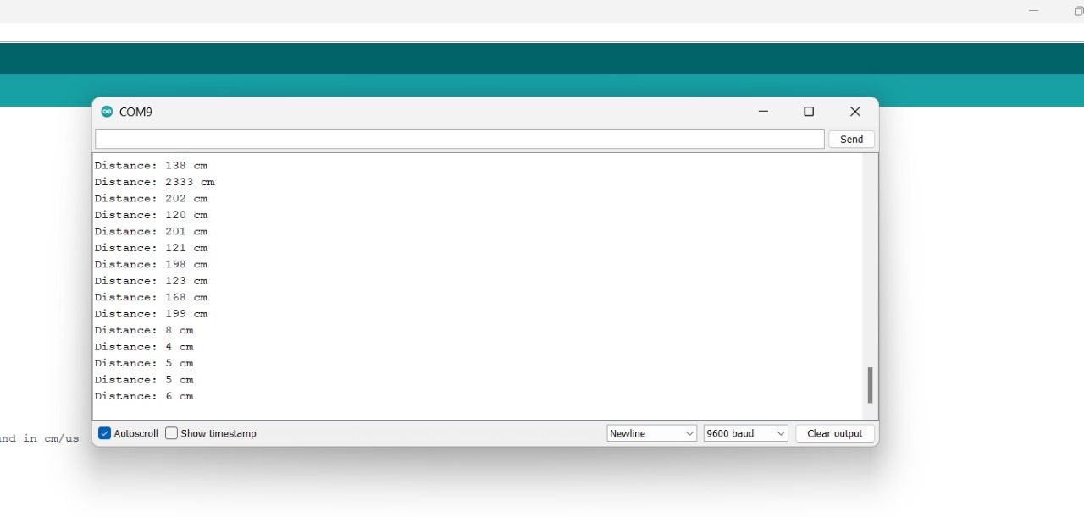
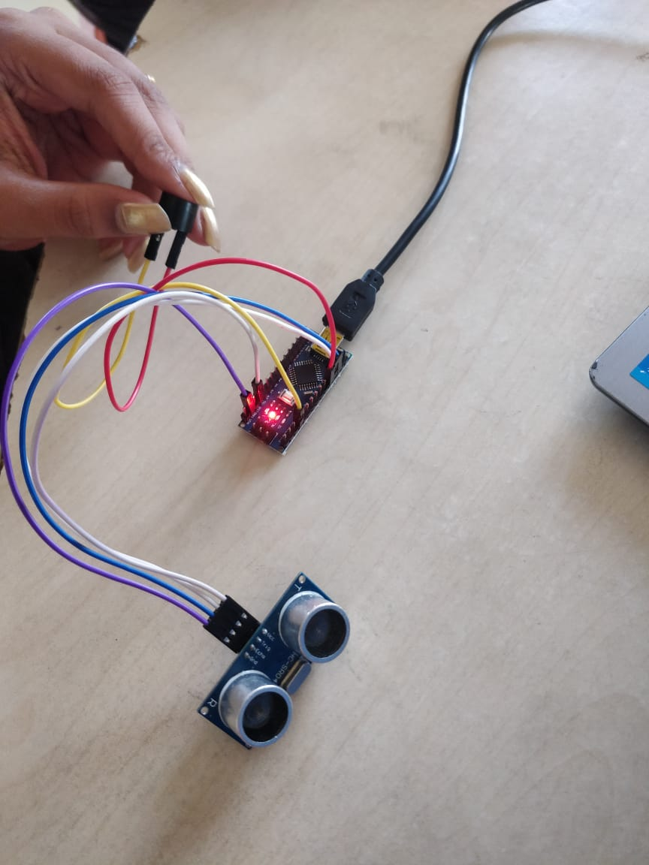
INITIAL OUTPUT

Slide 18
REFERENCES
References of conference/journal paper or books or website in the specified below
“Smart Assistive Shoes for Blind”,the authors are N. Sohan, S. Urs Ruthuja, H. S. Sai Rishab & R. Shashidhar of International Research Journal of Engineering and Technology.
“Internet of Things - Enabled Smart Shoes for Blind People”,the authors are Pratik Bhongade ,Sanyukta Girhay,Abdul Moeid Sheikh of IEE publication.
Teja Chava, A. Tarak Srinivas, A. Lohith Sai, Venubabu Rachapudi ,K L University ,IOT based smart shoe for blind, International Conference on Inventive Computation Technologies.

Slide 19
“Smart Footwear for the Visually-Impaired People Based on Arduino Platform and Ultrasonic Sensors”and the authors are Iuliana Chiuchisan, Oana Geman, Valentina Balas, Guojun Wang, Muhammad Arif, Haroon Elahi & Peng Tao of Springer publication.
“Design and Implementation of Smart Shoes for Blind and Visually Impaired People for More Secure Movements” and the authors are Jeffrey Chehade, Georgio Abou Haydar, Ali Hayek of International Conference on Microelectronics journal.

Slide 20
Thank You

